Slide 1
DREAM:lab Graph Subgroup Meeting - 1
Shriram R
12-Aug-19

Slide 2
Agenda
Problem Statement
Detailed Discussion & Brainstorming
Types of Graph
Structure, Motivation, etc.
Types of Queries
Novelty, Motivation, etc.
Indexing Strategies
Related Works, Other ideas, etc.
Miscellaneous

Slide 3
Problem Statement
Distributed system to answer a specific class of queries effectively on large temporal property graphs

Slide 4
Graph Model
Temporal property graphs
Nodes and Edges both have validities & properties
Append Only model
Assumptions
Entire graph should be able to reside in-memory spanning cluster
Snapshots or Interval graph is available
Points to Discuss
Need strong motivation for this model
Example datasets from Web, Social Network, Road Network, Finance etc.

Slide 5
Query Model
Queries to be supported by the system
Traversal type queries
Temporal Reachability
Temporal BFS
Temporal DFS
Temporal SSSP, EAT, LDT, FT
Well studied in literature with indexing strategies available
Comes under the class of path queries
Scope for distributed implementation

Slide 6
Query Model
Novel Queries
Should involve properties
Practical motivation
Some examples
Find a fastest path starting now in a road network that takes only a certain class (highways) of roads
Detect a fraudulent transaction pattern or find a money trail inside a transaction graph
Temporal graph mining (pattern matching)

Slide 7
GRAIL: Scalable Reachability Index for Large Graphs [3]
Reachability index based on randomized interval labelling
DAG based on SCCs is constructed from the static graph
Randomized DFS is performed and labels are assigned based on post order traversal
Can produce false positives
Recursive pruning technique is used to progress towards children of the source node

Slide 8
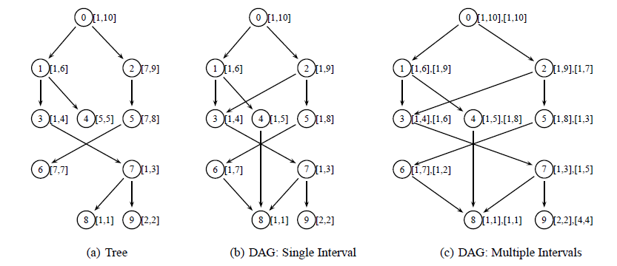
GRAIL: Scalable Reachability Index for Large Graphs [3]

Slide 9
FERRARI: Flexible and Efficient Reachability Range Assignment for Graph Indexing [4]
Interval Labelling scheme for reachability queries
Labels assigned to each vertex and associate a set of ranges to each vertex indicating reachability
Labelling is done from a tree cover of the graph
Optimization
Adaptively collapse certain ranges depending on a size constraint
Modelled as a dynamic programming problem
A greedy approach is taken to build the index

Slide 10
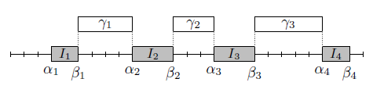
FERRARI: Flexible and Efficient Reachability Range Assignment for Graph Indexing [4]
Greedy Algorithm – Greedily add a new gap which minimizes the no. of points lying inside approximate interval (cost)
Querying
If the interval is exact then answer is known directly
Else, recursively expand the neighbours and use the index again

Slide 11
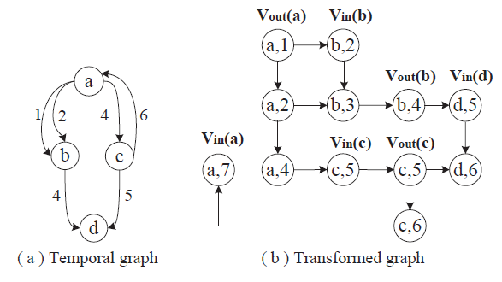
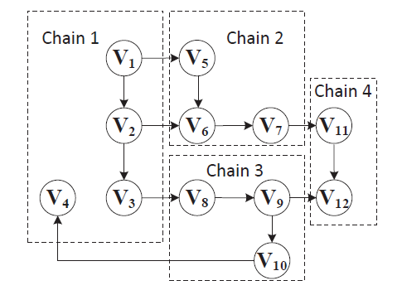
Reachability and Time-Based Path Queries in Temporal Graphs [1]
TopChain – Labelling Scheme for reachability queries
Chains are ranked in random or by max. degree
Each node is assigned top-k inV and outV labels

Slide 12
Reachability and Time-Based Path Queries in Temporal Graphs [1]
Performance Evaluation – 1 node, 2.0GHz, 128 GB RAM
Compared with PWAH8, TOL, GRAIL++, Ferrari, IP+, TTL, 1-pass
15 real temporal graphs with max. 273,909 snapshots
Index size is considerably close to other baselines
In average an order of magnitude improvement in query time
Gaps:
No distributed version of index structure
No support for path/reachability queries with property predicates

Slide 13
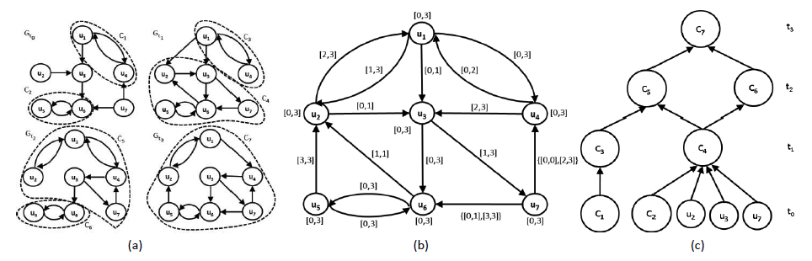
TimeReach: Historical Reachability Queries on Evolving Graphs [2]
Reachability queries – Conjunctive or Disjunctive
Find and minimize no. of SCCs across snapshots
Interval graph with SCCs is formed with In/Out labels

Slide 14
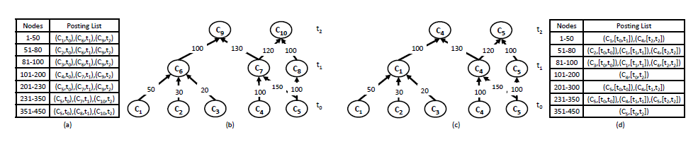
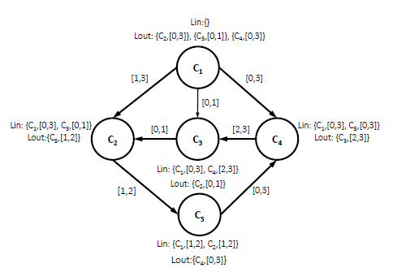
TimeReach: Historical Reachability Queries on Evolving Graphs [2]

Slide 15
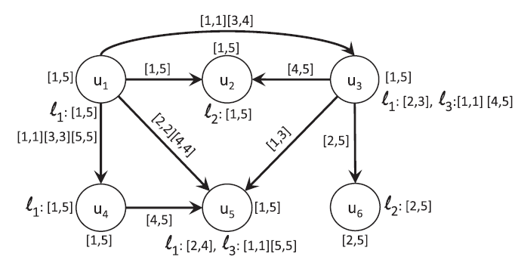
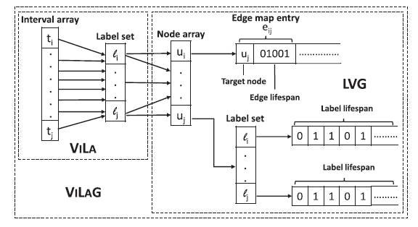
Top-k Durable Graph Pattern Queries on Temporal Graphs [4]
Finds subgraph matches that exist for longest period of time
Proposes compact representation of graph, time indexes & pruning strategies

Slide 16
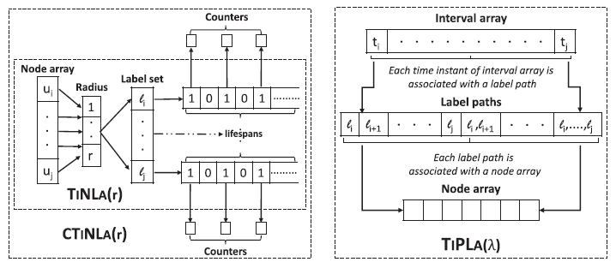
Top-k Durable Graph Pattern Queries on Temporal Graphs [4]

Slide 17
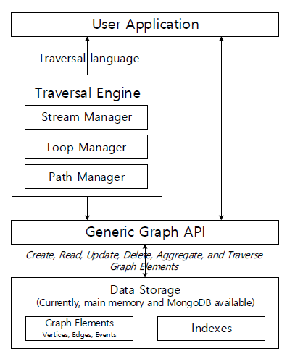
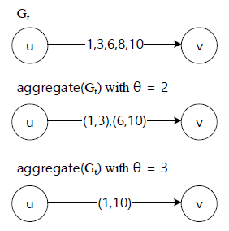
ChronoGraph: Enabling temporal graph traversals for efficient information diffusion analysis over time [2]
Traversal based query engine for Temporal graphs
Support for aggregating time points to intervals

Slide 18
ChronoGraph: Enabling temporal graph traversals for efficient information diffusion analysis over time [2]
Four types of steps in traversal :
Transform, filter, sideEffect & branch
Parallelized existing graph traversal methods & use lazy evaluation
Evaluation: Corei7, 32 GB memory, 16 GB heap environment
4 datasets with largest being 40M edges
Implemented temporal BFS, DFS and SSSP
Obtained up to an order of magnitude improvement
Compared with Neo4j, Titan, OrientDB etc.

Slide 19
References
Wu, Huanhuan, et al. "Reachability and time-based path queries in temporal graphs." 2016 IEEE 32nd International Conference on Data Engineering (ICDE). IEEE, 2016.
K. Semertzidis, E. Pitoura, and K. Lillis, “Timereach: Historical reachability queries on evolving graphs.” in EDBT, 2015, pp. 121–132.
H. Yildirim, V. Chaoji, and M. J. Zaki, “Grail: Scalable reachability index for large graphs,” Proceedings of the VLDB Endowment, vol. 3, no. 1-2, pp. 276–284, 2010.
S. Seufert, A. Anand, S. Bedathur, and G. Weikum, “Ferrari: Flexible and efficient reachability range assignment for graph indexing,” in 2013 IEEE 29th International Conference on Data Engineering (ICDE). IEEE, 2013, pp. 1009–1020.
Semertzidis, Konstantinos, and Evaggelia Pitoura. "Top-$ k $ Durable Graph Pattern Queries on Temporal Graphs." IEEE Transactions on Knowledge and Data Engineering 31.1 (2018): 181-194.
Byun, Jaewook, Sungpil Woo, and Daeyoung Kim. "ChronoGraph: Enabling temporal graph traversals for efficient information diffusion analysis over time." IEEE Transactions on Knowledge and Data Engineering (2019).

